Slide 1









Fitcheck

Slide 2




About Our
PROJECT
We Developed Calories Calculator and BMI (Body Mass Index) Calculator.

Slide 3

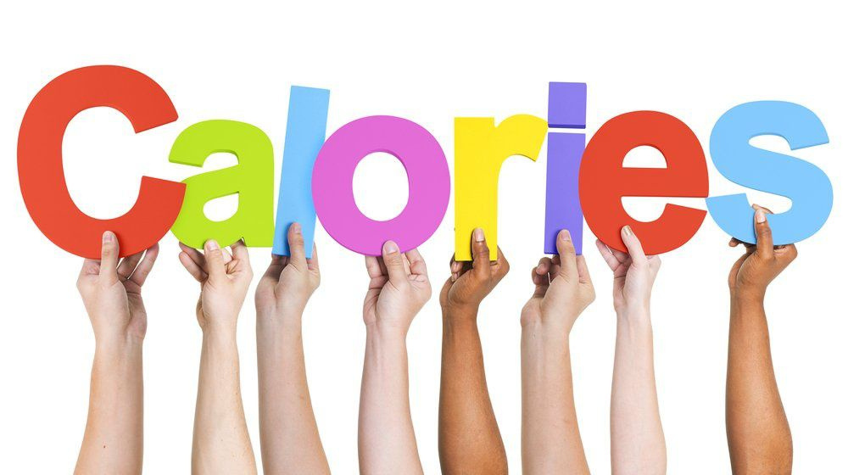


What is Calories?
The amount of energy in an item of food or drink is measured in calories. When we eat and drink more calories than we use up, our bodies store the excess as body fat. If this continues, over time we may put on weight.
How to Calculate it ?
Calorie Calculator can be used to estimate the number of calories a person needs to consume each day. This calculator can also provide some simple guidelines for gaining or losing weight.
Calorie Calculator is based on several equations, and the results of the calculator are based on an estimated average . women = 665.09 + (9.56 * weight) + (1.84 * height - (4.67 * age)) MALE = 66.47 + (13.75 * weight) + (5.0 * height - (6.75 * age))

Slide 4

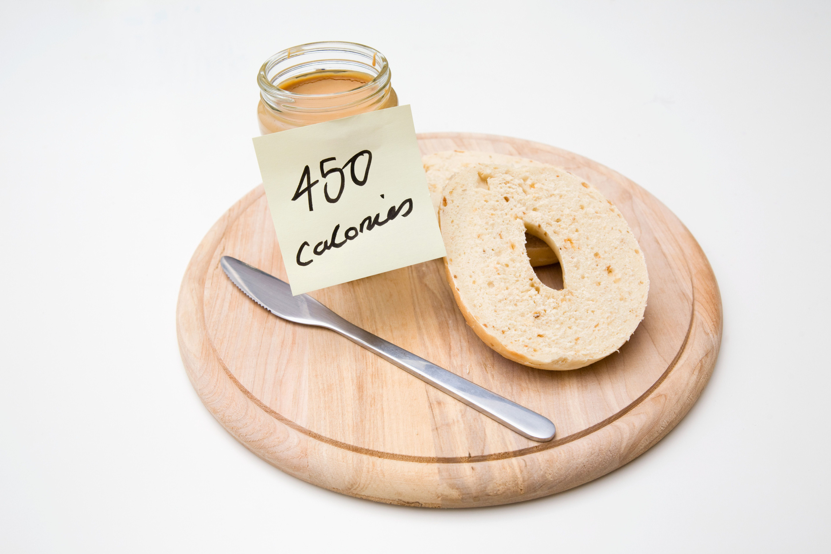
Leading The Way
More About Calories
It is important to remember that proper diet and exercise is largely accepted as the best way to lose weight. It is inadvisable to lower calorie intake by more than 1,000 calories per day, as losing more than 2 pounds per week can be unhealthy, and can result in the opposite effect in the near future by reducing metabolism.
Losing more than 2 pounds a week will likely involve muscle loss, which in turn lowers BMR, since more muscle mass results in higher BMR

Slide 5


BODY MASS INDEX
Introduction :
BMI is a measurement of a person's leanness or corpulence based on their height and weight, and is intended to quantify tissue mass.
It is widely used as a general indicator of whether a person has a healthy body weight for their height.
Specifically, the value obtained from the calculation of BMI is used to categorize whether a person is underweight, normal weight, overweight, or obese depending on what range the value falls between.

Slide 6

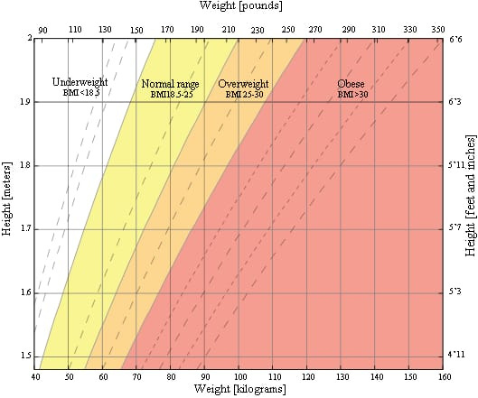
BMI chart for Adults

Slide 7



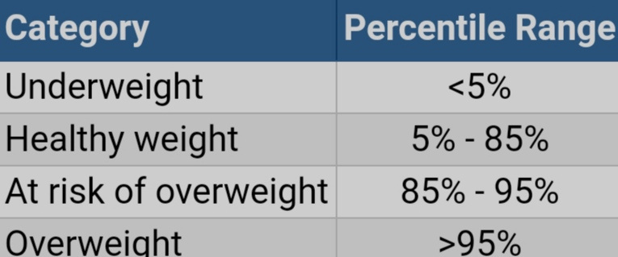

BMI table for children and teens, age 2-20

Slide 8

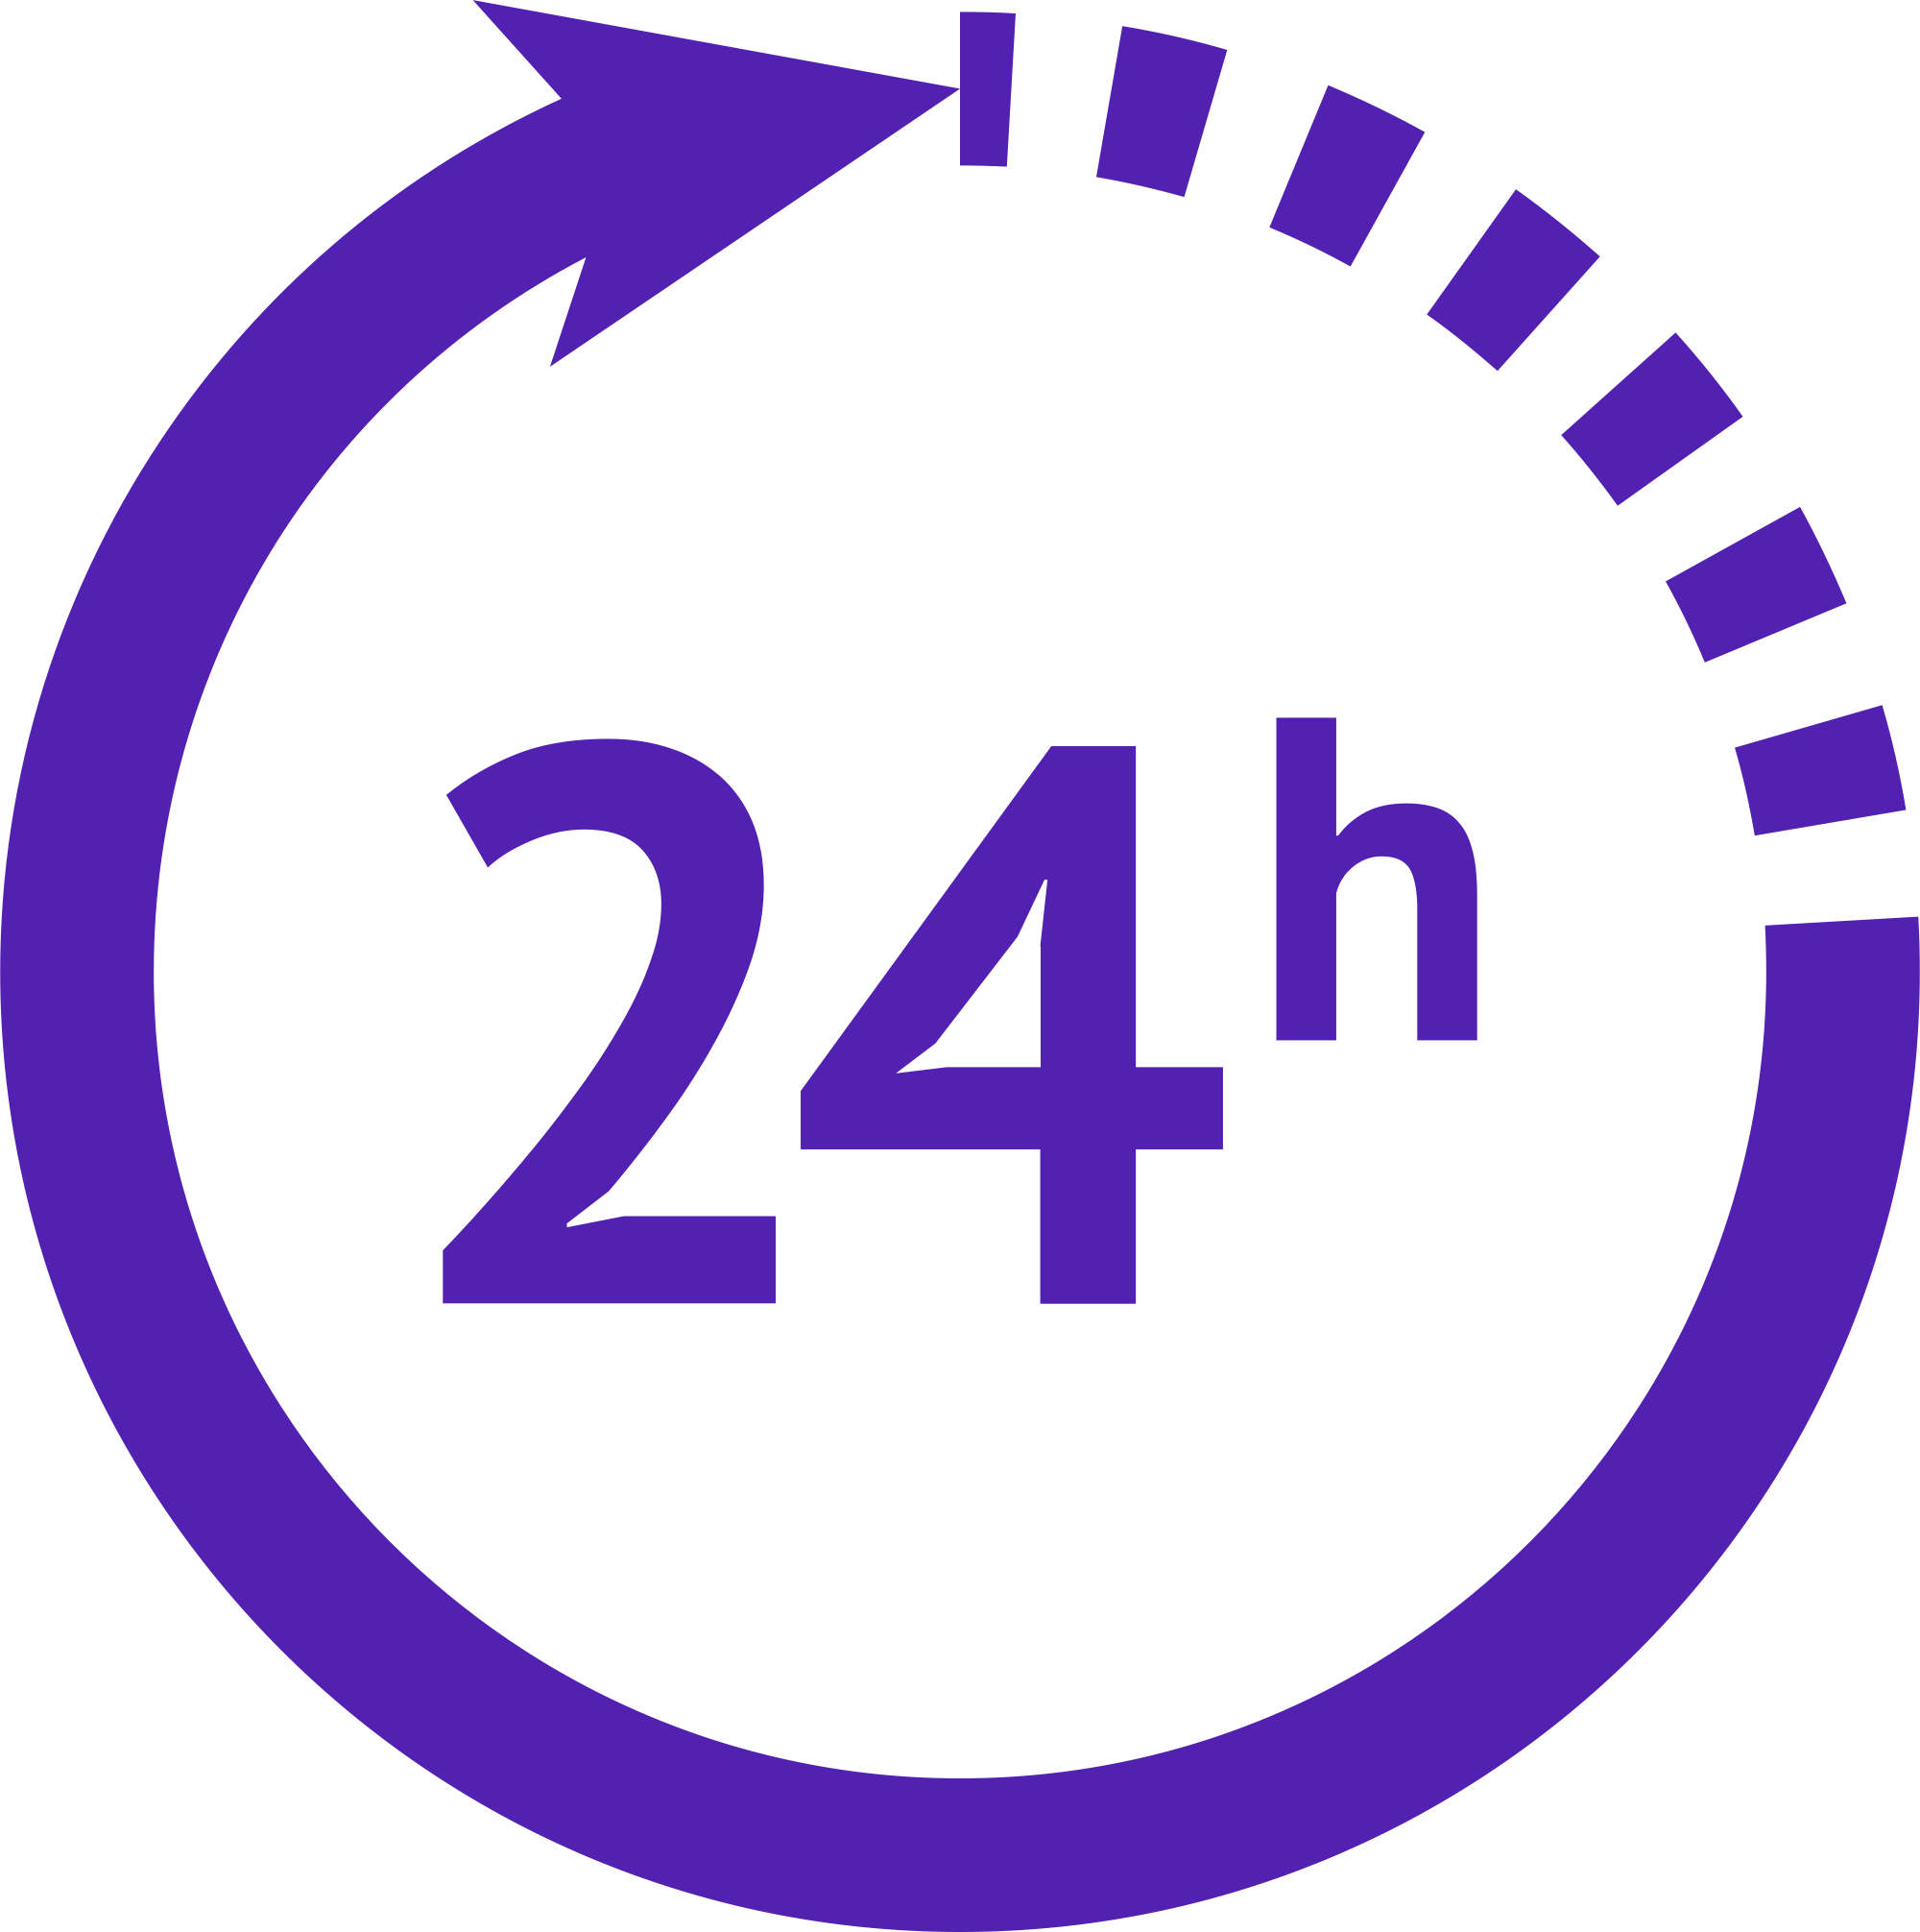

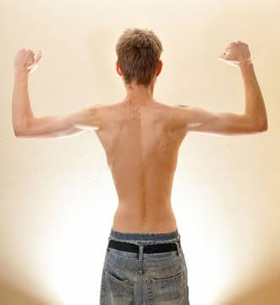
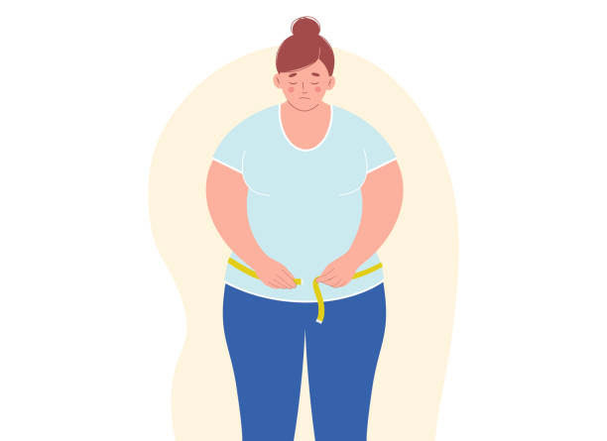
Risks associated with being
Risks associated with being Overweight
underweight
• Malnutrition, vitamin deficiencies, anemia
• Osteoporosis, a disease that causes bone weakness, increasing the risk of breaking a bone
• A decrease in immune function
Being overweight increases the risk of a number of serious diseases and health conditions.
Type II diabetes
Coronary heart disease Stroke
Gallbladder disease
High blood pressure
Mental illnesses such as clinical depression, anxiety, and others

Slide 9



Thank
You
- Corvus Team

